Slide 1


Conversational AI Chatbot for Tele-communication.
School of Continuing Studies-3760,
University of Toronto.
Jaspreet Bhatia.

Slide 2


AGENDA
Business Case.
Proposed Architecture.
Screenshots
Advantages/Limitations.

Slide 3
Business Case
Current scenario:
Huge amount of data flowing in daily.
Storing the voice/text transcripts.
Analysis of the conversations spoken in different languages (English , French etc.) for business cases (Internet, billing etc.)
Context-based Topic modeling for identifying the major issues in the conversations.
Storing the results of the topic model.

Slide 4
CLOUD TECHNOLOGY
Google Cloud Platform.
Google CCAI Insights – Topic Model.
Speech to text API
Custom Highlights.

Slide 5
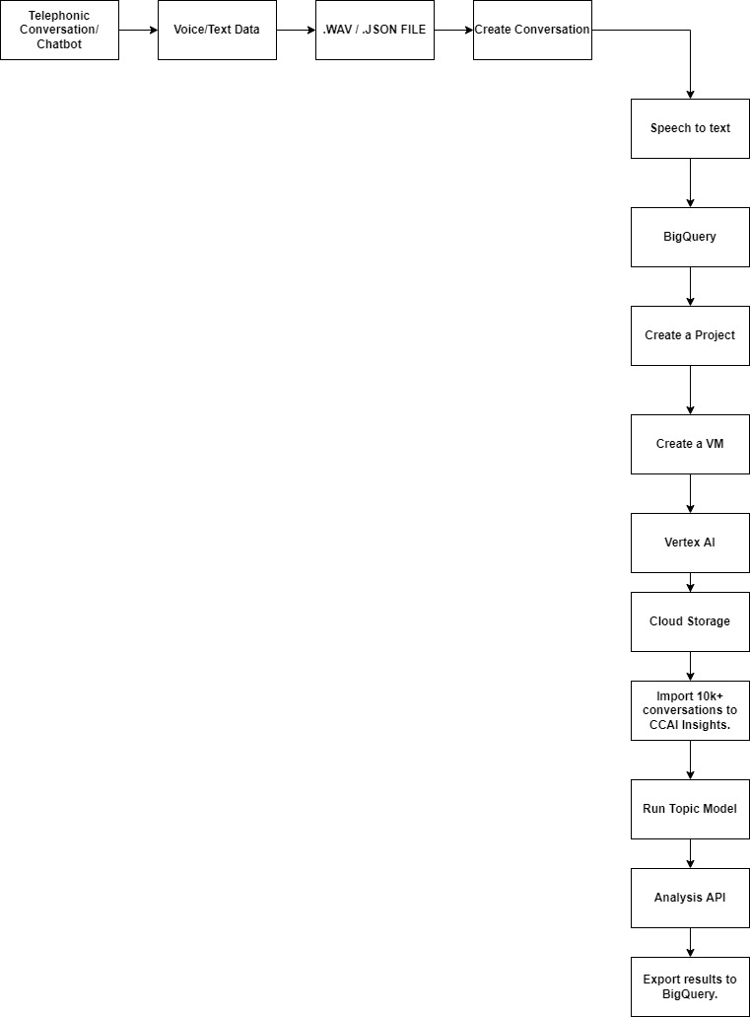
Proposed Architecture

Slide 6

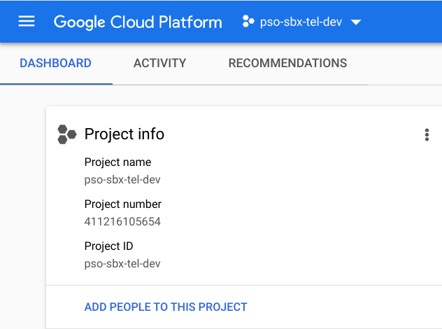
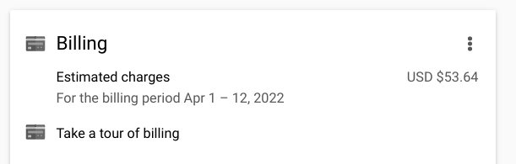
PROJECT

Slide 7
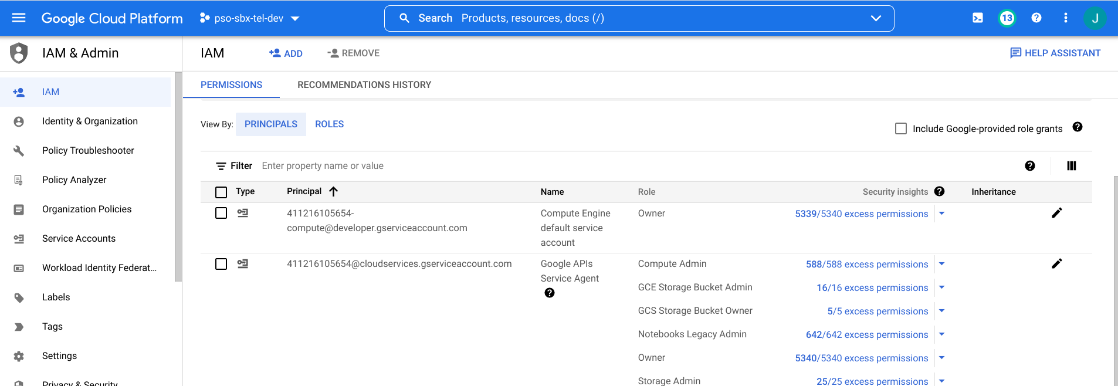
Project I AM Roles

Slide 8
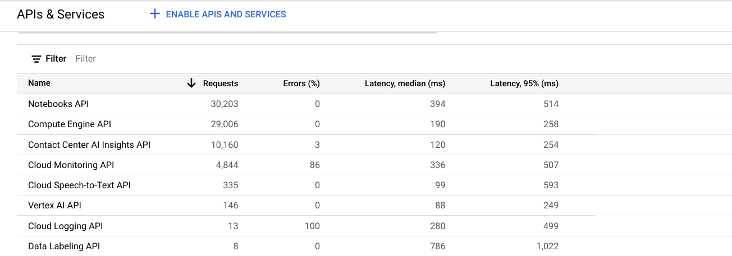
API

Slide 9
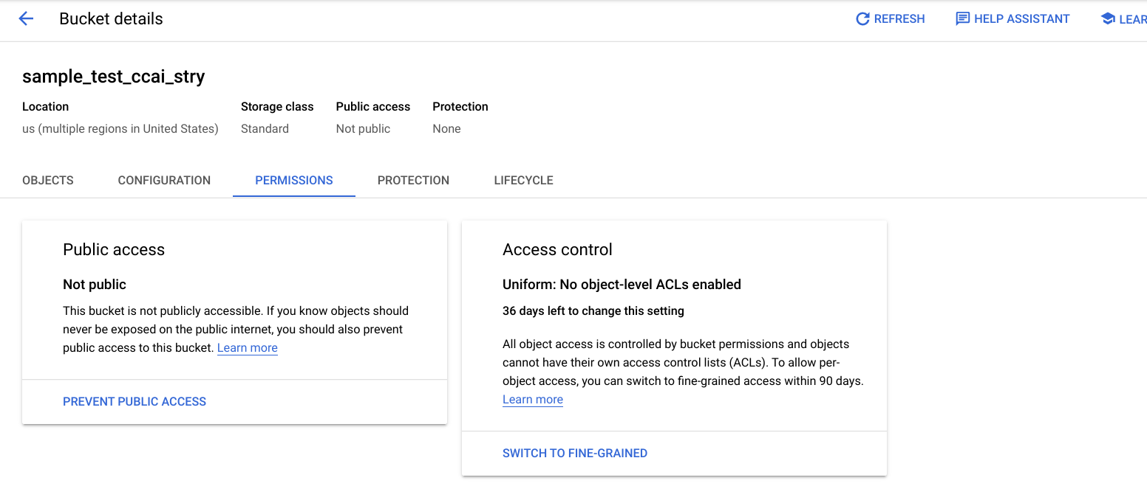
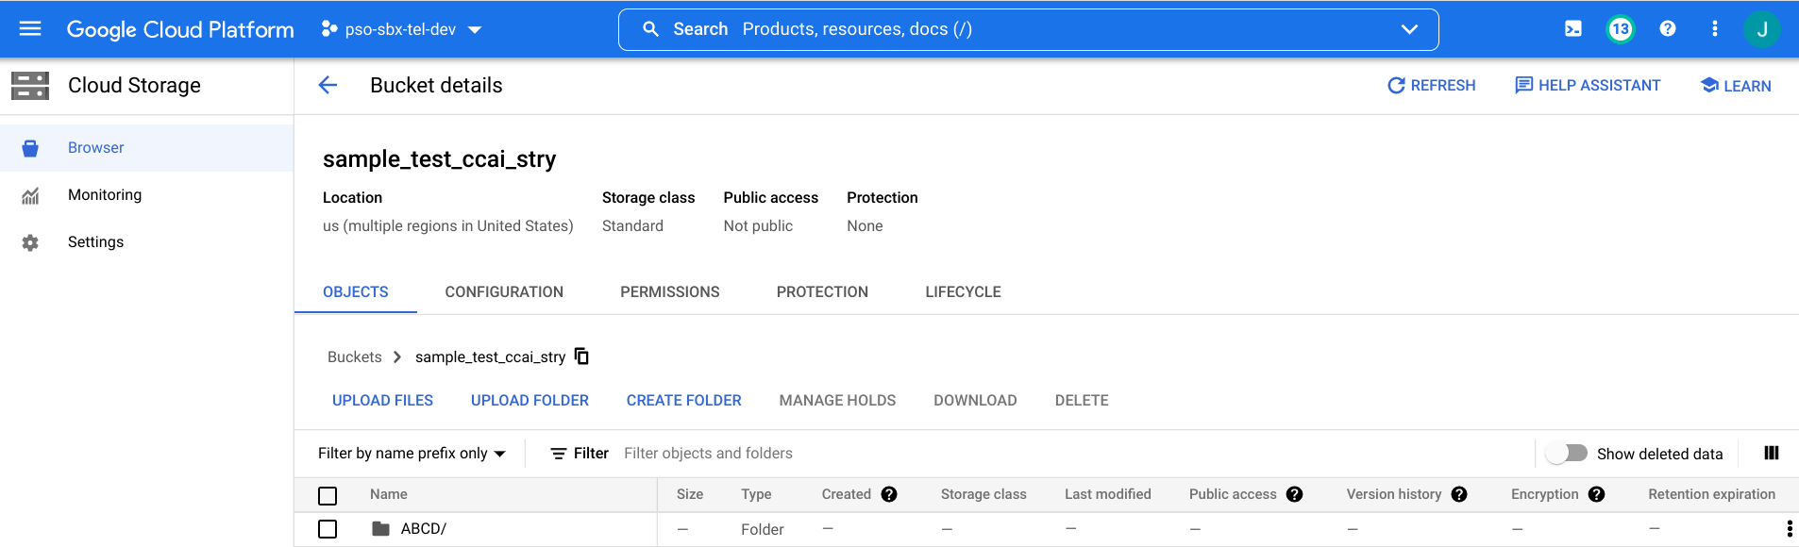
CLOUD STORAGE

Slide 10
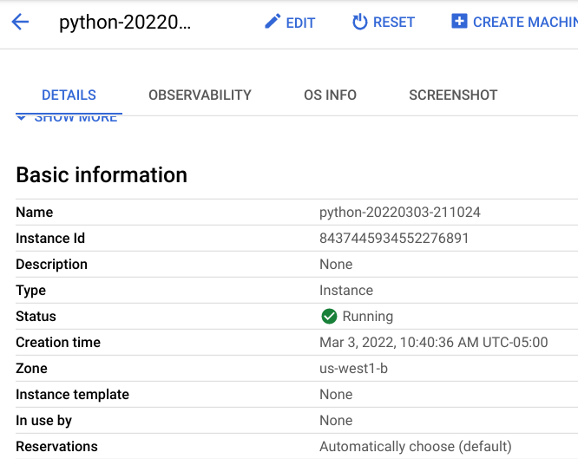
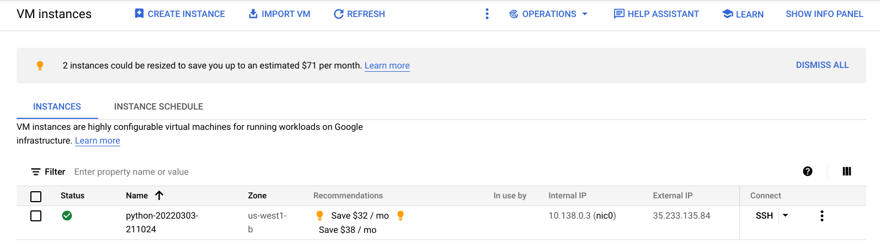
VM INSTANCE

Slide 11
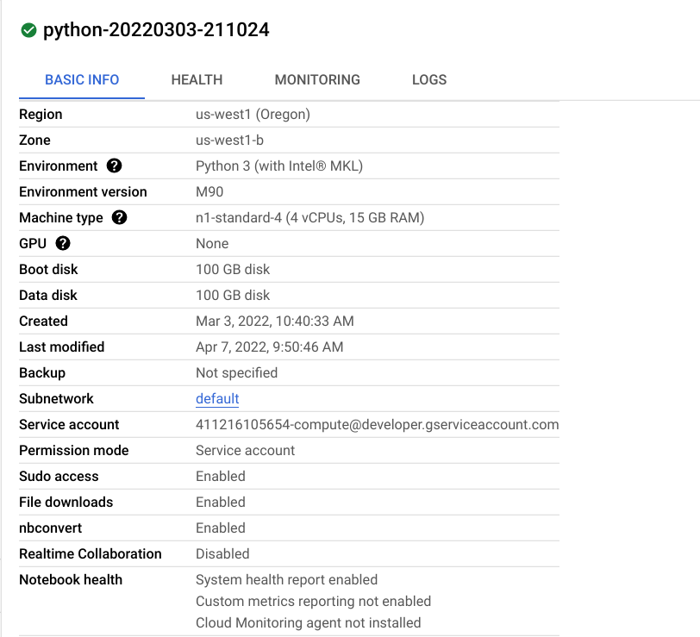
VERTEX AI WORKBENCH

Slide 12
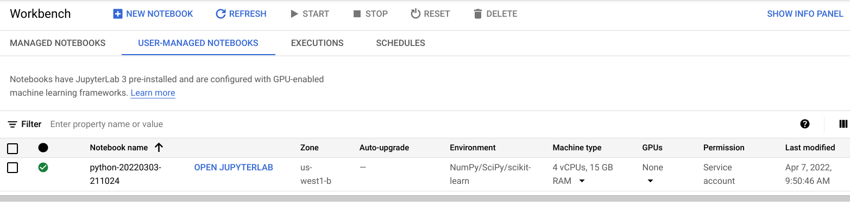
NOTEBOOK DETAILS

Slide 13
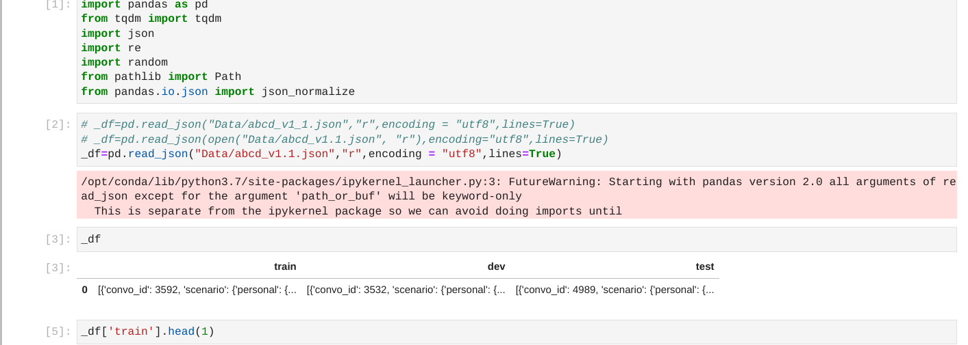
NOTEBOOK

Slide 14
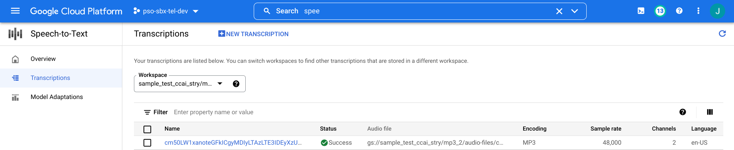
SPEECH-TO-TEXT

Slide 15
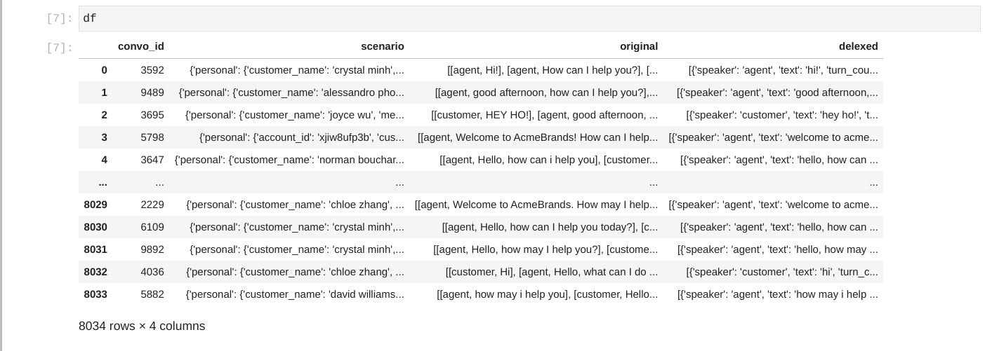
Action Based Conversation Dialogue (ABCD) Dataset.

Slide 16
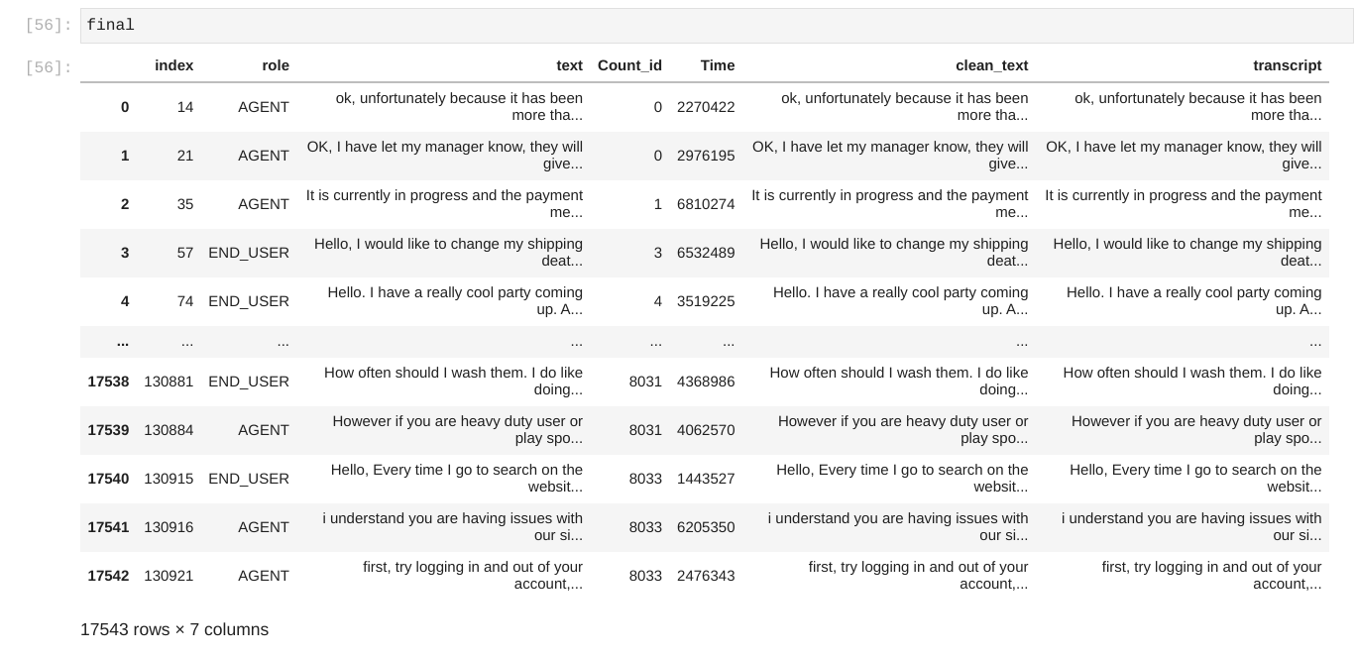
DATA CLEAN-UP

Slide 17
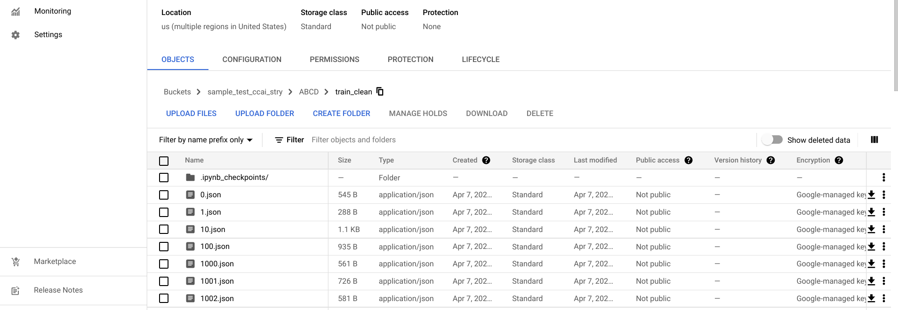
OUTPUT FILES TO CLOUD STORAGE

Slide 18
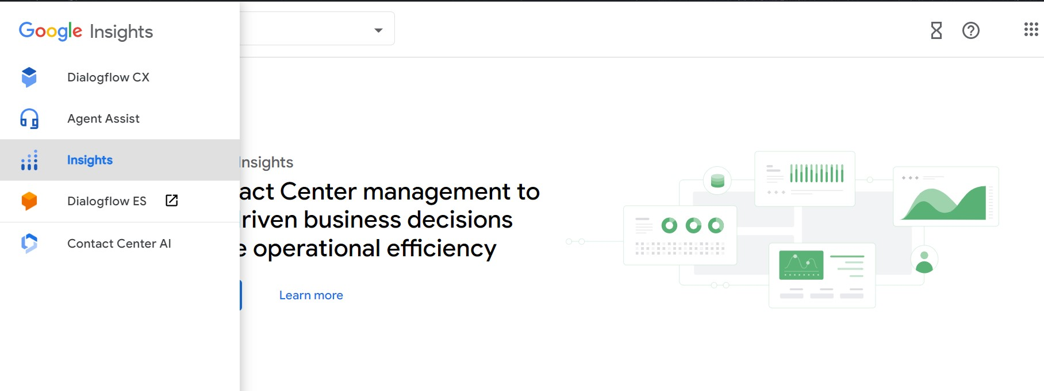
GOOGLE CCAI INSIGHTS

Slide 19
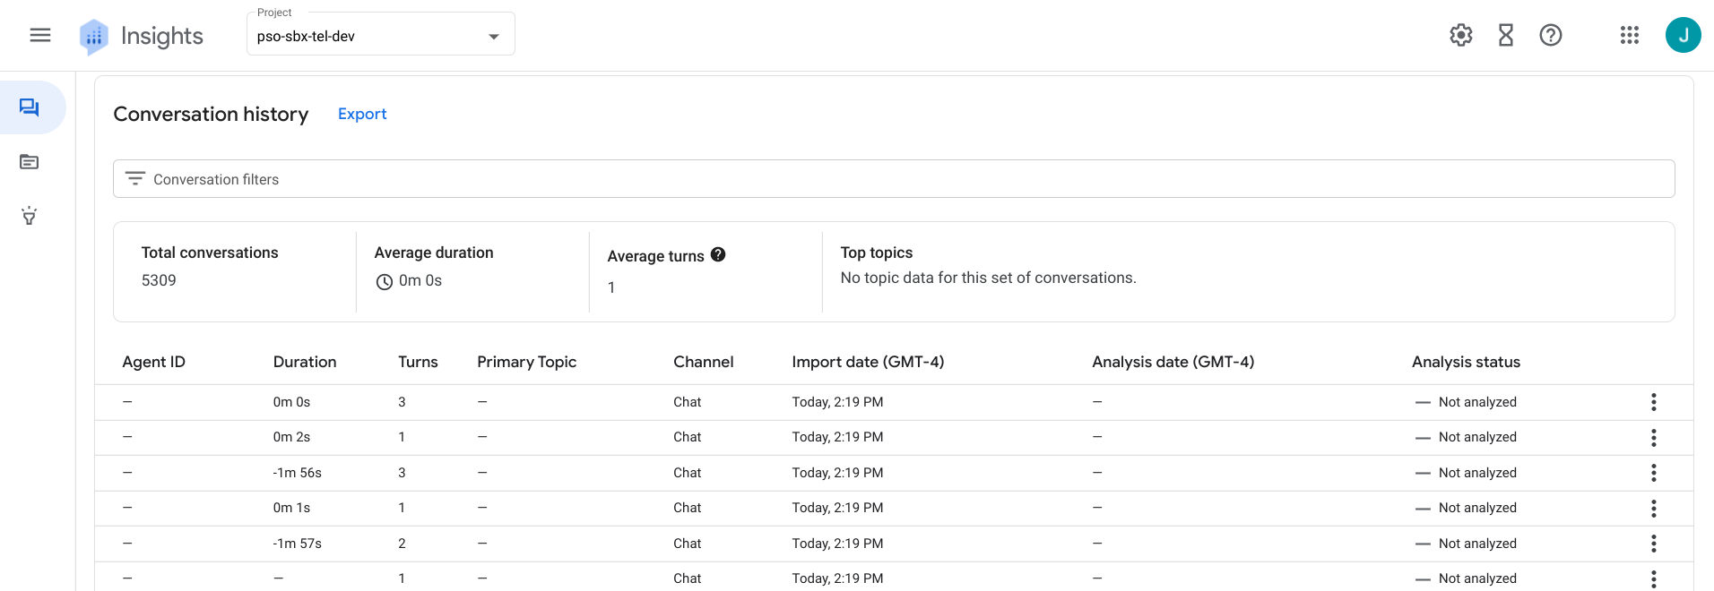
CONVERSATION HUB

Slide 20
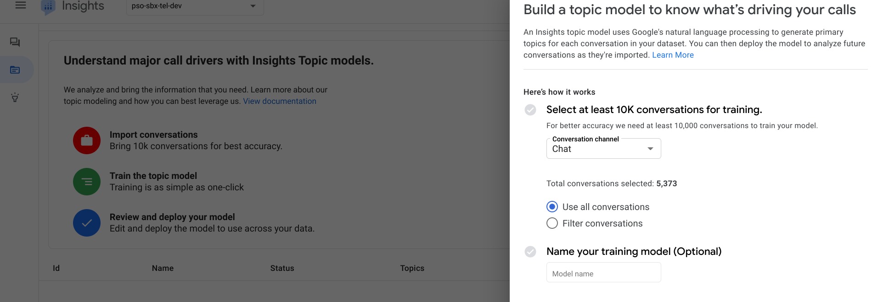
TOPIC MODEL

Slide 21
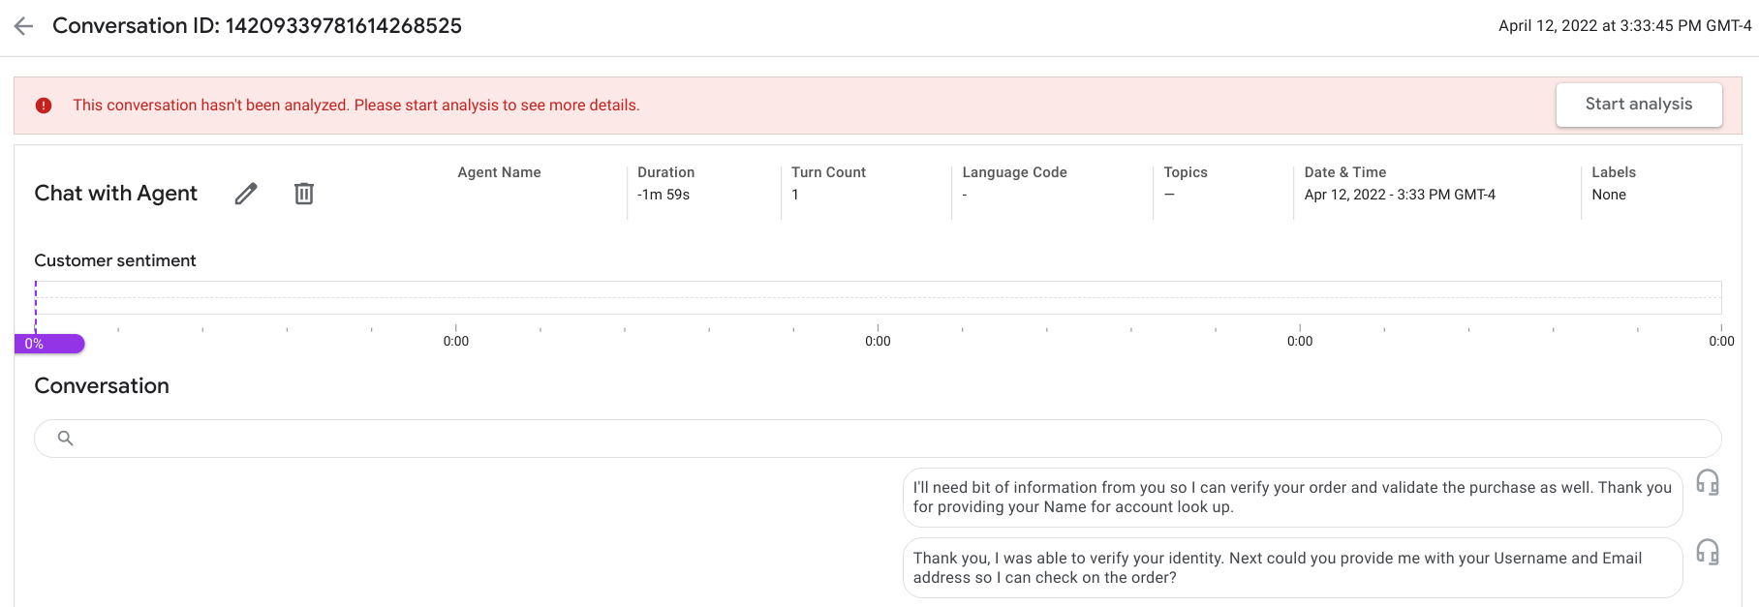
ANALYSIS API

Slide 22
LIMITATIONS
Conversations may contain personal details like Credit card, Pin number etc.
Speech to text should correctly highlight more important phrases after conversion.
Data Privacy to be maintained.
Huge data storage, storage time, data analysis required.
Updating the input data as more data flows in from different business use-cases.
Topic Model to be updated over time.

Slide 23
REFERENCES
UofT class lectures/notes/assignments.
Google Cloud Documentation.
Google CCAI documentation.
NLP textbooks.
ABCD open-source dataset.

Slide 24

Thank You

